Slide 1
COMPANY PERSONA
END USER - EPIC
WHO?
COMPANY BACKGROUND
Segment: Food
Revenue: > $800M
Growth rate: > 3% annually
DEMONGRAPHIC
High growth: Increased store counts, capital spending
Category: Retail, Wholesale,
Not a technology early adapter
Sophisticated Operation team: leader in advanced technology development
CORE VALUE
Customer service centric
Unified commerce to increase revenue
Customer experience and engagement
Payment/data security
GOALS
Priorities
CHALLENGES
Improving financial performance

Slide 2
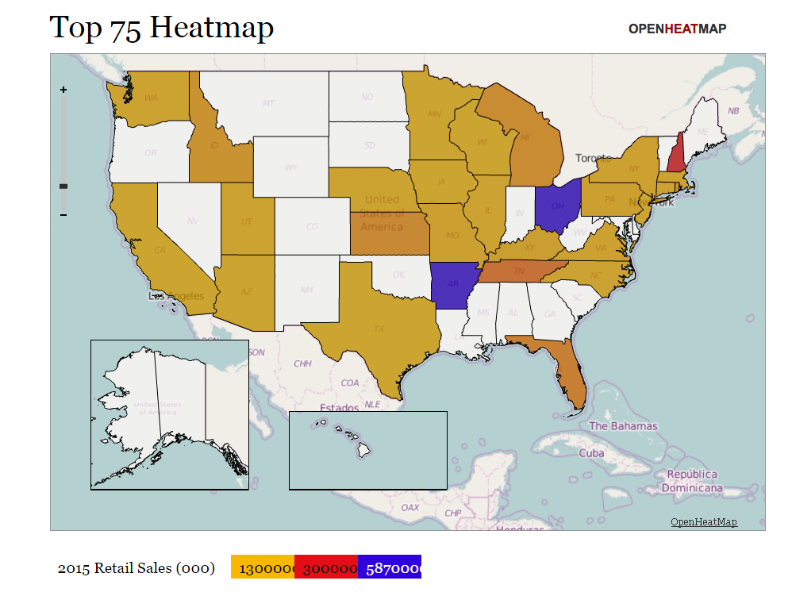
COMPANY PERSONA
END USER - EPIC
DEMONGRAPHIC
Headquarter locations
2016 – 10 Fast Growing Chains

Slide 3
COMPANY PERSONA
END USER - EPIC
Name | 2015 Retail Sales (billion$) | 2015 # of US Stores | Capital Spending Increased | Employee in Operation | Background Info
Kroger | $109.8 | 3732 | 25% | 18% | Supermarkets (including 1330 fuel centers):2623, Convenience stores 783, Fine jewelry stores:326
Publix | $32.4 | 1116 | 15.4% | 16% | High employee retention
Dollar General | $15.3 | 12483 | 14% | 14% | Operate over 12,400 stores including Dollar Genearl Market which is a chain of hypermarkets that also sells fresh groceries and produce.
Smart & Final | $3.97 | 266 | 20% | 17% | LA based. Acquired by Haggen.
Kroger
Publix
Dollar General
Smart & Final
TARGETS

Slide 4
COMPANY PERSONA
END USER - EPIC
2015 Revenue: $1 billion
2016 Store Count: 150
Headquarter: Lifflefield, TX
2016 SN Ranking in the Top 75: #74
Small chain
Store locations: South and west of Texas, New Mexico
Lowe’s Market

